Slide 1
Spring Boot
Day 1-2

Slide 2
Objectives
Introduction to Spring Boot
Intro to Spring Boot - What is Spring Boot and What It Does
Advantages / Features of Spring Boot
Spring Boot Hello World example
@SpringBootApplication=@Configuration + @ComponentScan + @EnableAutoConfiguration
SpringApplication.run() method

Slide 3
Objectives
Configuration and Customization, Devtools
Working with Properties - YAML and .properties
Advantages of YAML over .properties files
Auto-configuration Overview
Need of DevTools

Slide 4
Objectives
Creating profiles in spring boot
Need of profiles?
Creating profiles using .yml and .properties files
Selecting specific profile

Slide 5
Let’s Review Spring quickly……
Architecture of Spring
Spring core-
AOP
Data integration layer
Testing
IOC – inversion of control
DI – Dependency injection
Setter or property injection
Constructor injection
Configuration file – config.xml
We have to define or specify our beans
IOC container will create object and inject as per requirements but while doing this IOC will also consider types.
Primitive
Collection
Reference type

Slide 6
Let’s Review Spring quickly……
Autowiring
Lifecycle of Bean
Public void init()
Public void destroy()
Standalone collections
Annotations
@Autowired
@Qualifier

Slide 7
Let’s Review Spring quickly……
Stereotype Annotation
@Component
@Value
Bean scope
Singleton
Prototype
Spring JDBC
It is built on top of JDBC API
We will have to use JdbcTemplate class in order to perform all operation.
RowMapper – (Interface)

Slide 8
Let’s Review Spring quickly……
Spring AOP
Cross cutting concerns
Aspect
Advices
Join points
Point cut
Spring MVC.
Dispatcher Servlet
ViewResolver
Controller
RequestMapping

Slide 9
Intro to Spring Boot - What is Spring Boot and What It Does
Spring boot is basically a spring module which is developed to simplify use of spring framework for java development.
It is also used to create standalone spring base applications.
Spring boot removes lot of configuration and dependencies and helps us to develop an application faster than usual.
Spring boot automatically does all configuration, add dependencies, for Http server will also be embedded.
Spring boot is going to be very efficient while developing applications.
Note- Spring boot is also a module of spring framework use to develop java base application very efficiently.

Slide 10
Intro to Spring Boot - What is Spring Boot and What It Does
Java Spring Framework (Spring Framework) is a popular, open source, enterprise-level framework for creating standalone, production-grade applications that run on the Java Virtual Machine (JVM).
Java Spring Boot (Spring Boot) is a tool that makes developing web application and microservices with Spring Framework faster and easier through three core capabilities:
Autoconfiguration
An opinionated approach to configuration
The ability to create standalone applications

Slide 11
Intro to Spring Boot - What is Spring Boot and What It Does
Features of Spring Boot:
Spring CLI → Spring CLI helps us to boost our application development process and avoid boilerplate code.
Spring Initializer → This is basically a web base application, which can create an internal project structure for you.
Spring Actuator →This feature helps s while running our spring boot application.
Starter Dependencies-> Using this, spring boot will manage all recommended dependencies and add in our project
Auto Configuration → While creating spring boot application all basic and recommended configuration will be done automatically.
Logging and Security --> The functionality of logging will be available here in Spring boot and Spring boot will also provides lots of security mechanism for our application.

Slide 12
Intro to Spring Boot - What is Spring Boot and What It Does
Why Spring Boot?
Stability
Based on JVM
Connectivity
Cloud native
Flexible
Open source.

Slide 13
Spring Vs Spring Boot
Spring Application are quite heavy than spring boot applications and spring applications takes more time to load and run with compared to spring boot application while spring boot application are light weighted and can load and run faster.
While working with spring, have to manage life cycle of java but in case of spring boot we don’t have to worry about it.
Spring is going to be considered as Dependency injection framework while spring boot is preconfigured.

Slide 14
Understanding Starter POMs
Dependency management is a critical aspect of any complex project. And doing this manually is less than ideal; the more time you spent on it the less time you have on the other important aspects of the project.
Spring Boot starters were built to address exactly this problem. Starter POMs are a set of convenient dependency descriptors that you can include in your application. You get a one-stop-shop for all the Spring and related technology that you need, without having to hunt through sample code and copy-paste loads of dependency descriptors.
We have more than 30 Boot starters available – let's see some of them in the following sections.

Slide 15
Understanding Starter POMs
1. The Web Starter
First, let's look at developing the REST service; we can use libraries like Spring MVC, Tomcat and Jackson – a lot of dependencies for a single application.
Spring Boot starters can help to reduce the number of manually added dependencies just by adding one dependency. So instead of manually specifying the dependencies just add one starter as in the following example:
<dependency>
<groupId>org.springframework.boot</groupId>
<artifactId>spring-boot-starter-web</artifactId>
</dependency>
Now we can create a REST controller. For the sake of simplicity we won't use the database and focus on the REST controller

Slide 16
Understanding Starter POMs
2. The Test Starter
For testing we usually use the following set of libraries: Spring Test, JUnit, Hamcrest, and Mockito. We can include all of these libraries manually, but Spring Boot starter can be used to automatically include these libraries in the following way:
<dependency>
<groupId>org.springframework.boot</groupId>
<artifactId>spring-boot-starter-test</artifactId>
<scope>test</scope>
</dependency>
Notice that you don't need to specify the version number of an artifact. Spring Boot will figure out what version to use – all you need to specify is the version of spring-boot-starter-parent artifact. If later on you need to upgrade the Boot library and dependencies, just upgrade the Boot version in one place and it will take care of the rest.

Slide 17
Understanding Starter POMs
3. The Data JPA Starter
Most web applications have some sort of persistence – and that's quite often JPA.
Instead of defining all of the associated dependencies manually – let's go with the starter instead:
<dependency>
<groupId>org.springframework.boot</groupId>
<artifactId>spring-boot-starter-data-jpa</artifactId>
</dependency>
<dependency>
<groupId>com.h2database</groupId>
<artifactId>h2</artifactId>
<scope>runtime</scope>
</dependency>
Notice that out of the box we have automatic support for at least the following databases: H2, Derby and Hsqldb. In our example, we'll use H2.

Slide 18
Spring DevTools and Live Reload Spring Boot Fundamentals.
DevTool stands for Developer tool. It has been developed to minimize development time of java application while working with spring boot application. Spring boot devtools pick up changes and restart application automatically.
For achieving this we will first have to add one dependency in our POM.xml by name spring-boot-devtools.
<!-- https://mvnrepository.com/artifact/org.springframework.boot/spring-boot-devtools -->
<dependency>
<groupId>org.springframework.boot</groupId>
<artifactId>spring-boot-devtools</artifactId>
<version>2.6.3</version>
</dependency>

Slide 19
Spring DevTools and Live Reload Spring Boot Fundamentals.
After adding dev-tools in our project it will offers us some features as below:
Property default → when sometimes we will have to use templates. Templates are nothing but just some UI pages, when we use such templates in our spring boot application at that time these templates save in our cache memory. So if you will make changes once your template saves in cache memory then changes won’t appear because you are getting view from your cache memory but when we will use DevTools then automatically the properties of cache will be set to false so our data won’t save in cache and whatever changes you will do, those all changes will appear directly which will boost your development speed.
Automatic restart→ when we will use DevTools in our project then it will keep checking class path of our project. So whenever you will do changes then it will check class path and it will restart our application automatically.
Live Reloading →This feature will helps us to get recently modification in our UI pages that is we can say templates as soon as we will make changes. Same like Live server in VS code.
It also support Remote Application, Remote debugging.

Slide 20
DI – Dependency Injection
Note -> @SpringBootApplication this annotation performs three tasks.
configuration
EnableAutoConfiguration
ComponentScan
For above all three annotation only one annotation that is @SpringBootApplication works

Slide 21
Spring Profiles
Profiles are a core feature of the framework — allowing us to map our beans to different profiles — for example, dev, test, and prod.
We can then activate different profiles in different environments.
Scenario:-
Let’s consider you are working on development phase and development completed then you have to put your application in production phase so, in that case it maybe possible that configuration will be different then instead of doing changes in existing file we will create new configuration for another environment.
For this purpose we will create new file but it’s name should be as given below:
Application-dev.properties in src/main/resources
(Try with new Demo)

Slide 22
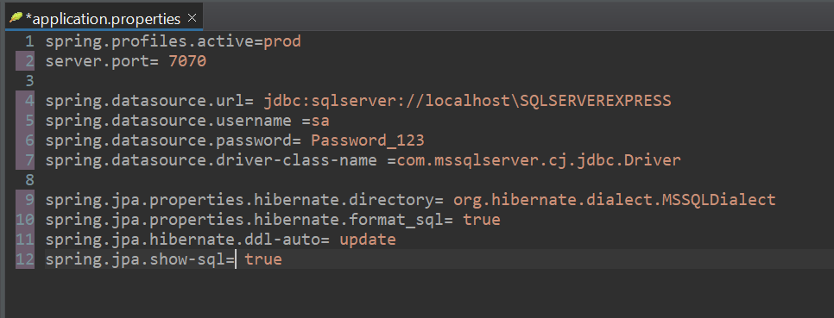
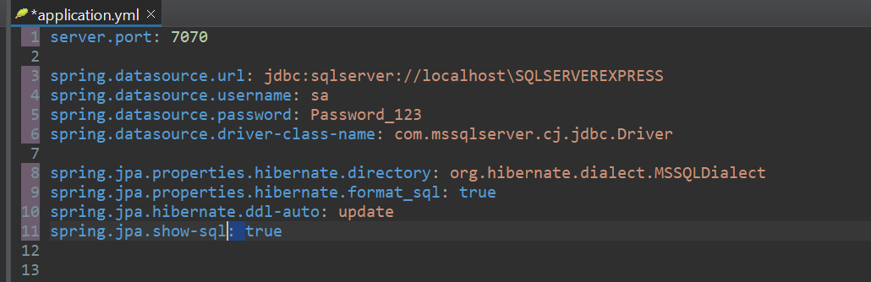
Spring .properties Vs .yml
Properties and yml files both are used for configuration purpose.

Slide 23
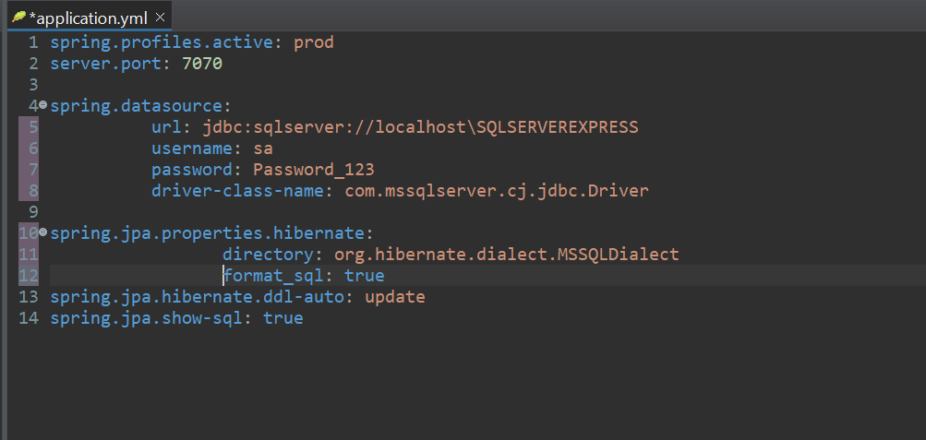
Spring .properties Vs .yml
Yml file provides us nesting means can have nested properties.
In yml it can accommodate different data types
We don’t have to provide “ ” for string. Automatically for text it will be treated as text
Number will be automatically treated as numbers

Slide 24
Spring Actuator
Visit:
https://docs.spring.io/spring-boot/docs/current/reference/html/actuator.html
Steps for implementing Actuator
Step 1: Create new project
Step 2: add dependency of actuator:
<dependency>
<groupId>org.springframework.boot</groupId>
<artifactId>spring-boot-starter-actuator</artifactId>
</dependency>

Slide 25
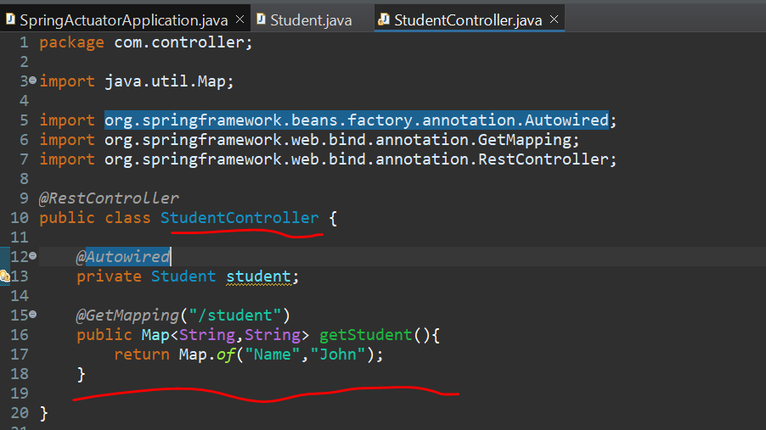
Spring Actuator
Step 3. Add a package controller
Step 4. Add a class StudentController create a method in it as handler method

Slide 26
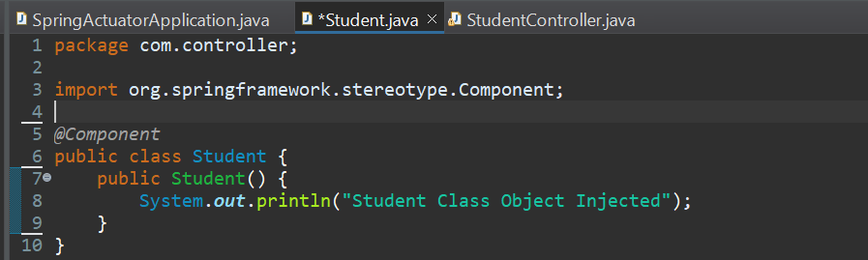
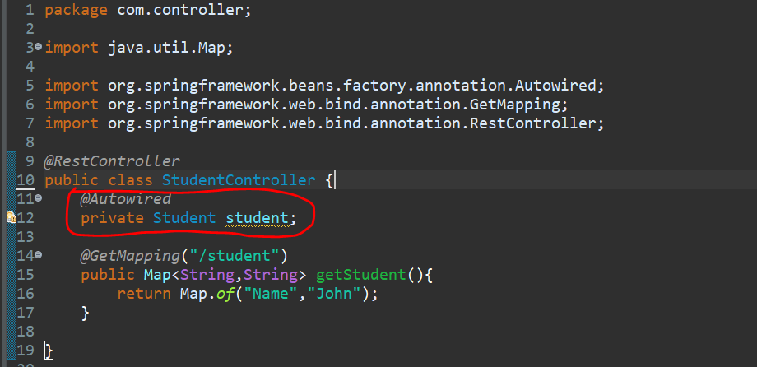
Spring Actuator
Step 5. Create new class in controller as Student and simply add a constructor.
Step 6. Create object of it in StudentController and use @Autowired.

Slide 27
Spring Actuator
Step 7. Run the code and you will see one actuator is present. By using it’s mapping we can get to know about endpoints.
Step 8. In case if you will have to add more endpoints then refer the documentation for specification and purposes of different endpoints.
Step 9. Open application.properties and add endpoints to given below property.
management.endpoints.web.exposure.include=beans, health
Or if you want to add all endpoints then you can simply add *
management.endpoints.web.exposure.include=*
If you have to exclude some endpoints then use exclude instead of include.
If you want to change mapping of actuator then you can add
management.endpoints.web.base-path=/admin

Slide 28
Spring Boot MVC

